Slide 1
CISC 322/326 Assignment3
Enhancement Proposal
Ikun family
2023-04-08

Slide 2
https://youtu.be/xmK8JYKDm1g
01

Slide 3

Team numbers
Jinyang Chen 19jc66@queensu.ca
（Seader/Reporter）
Rundong Yu 18ry16@queensu.ca Speaker/ppt
Chiyu Wang 19cw33@queensu.ca
Reporter
Gaoyuan Bao19gb20@queensu.ca
Speaker/reporter

Slide 4
CONTENT
Introduction
Value and Benefits
Disadvantages
Approach 1: Integrated Lightning Network Implementation: Transcation
Approach 2: External Lightning Network Wallet Integration : Mining

Slide 5
Introduction
02

Slide 6
Introduction
As a Bitcoin wallet designer, we are adding the Lightning Network design as an enhancement to my Bitcoin wallet framework could bring several benefits to my project. In this presentation, we will explain the value and benefits of adding the Lightning Network design, as well as the disadvantages of doing so. Furthermore, we will present two approaches to realize a new function with its stakeholders, clearly outline the advantages and disadvantages of each approach
In this report, we demonstrate that integrating Lightning Network support into the architecture of Bitcoin wallets will greatly enhance user experience. The Lightning Network, which enables quicker and less expensive transactions, is generally recognized as Bitcoin‘s Layer 2 scaling solution. Lightning transactions can be executed without having to log each transaction on the Bitcoin blockchain by establishing a network of payment channels between users. Users will benefit from quicker and less expensive transactions as a result

Slide 7
SAAM analysis
An SEI SAAM architectural analysis consists of:
1. Identifying the major stakeholders of the proposed enhancement.
2. Identifying, for each such stakeholder, the most important non-functional requirements (NFRs) regarding the enhancement.
3. Evaluating for the suggested ways to realize your enhancement how it impact each identified NFR and stakeholder.
4. Determining which way to realize the enhancement is the overall best one based on the analysis of the previous step.

Slide 8
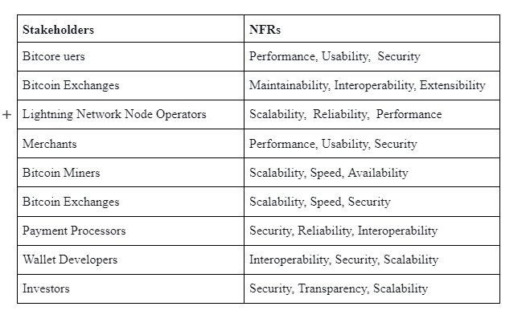

Slide 9
Value and Benefits
03

Slide 10
Value and Benefits
Adding the Lightning Network design to my Bitcoin wallet framework could bring several benefits, such as:
Faster transactions
Scalability
Lower fees
Improved user experience

Slide 11

Adding the Lightning Network design could bring several benefits, such as:
Faster transactions:
The Lightning Network enables faster and cheaper Bitcoin transactions by creating a layer 2 payment channel network that can process transactions instantly and at a lower cost than on-chain transactions.
Scalability:
The Lightning Network enables a higher transaction throughput, making it possible to process more transactions per second than on-chain transactions.
Lower fees:
The Lightning Network enables lower transaction fees than on-chain transactions, making it more cost-effective for users.
Improved user experience:
The Lightning Network enables users to make instant payments without the need for confirmations, improving the user experience.

Slide 12
Disadvantages
04

Slide 13

However, some potential risk to adding the Lightning Network design, such as:
Complexity:
Implementing the Lightning Network design adds complexity to the wallet framework and requires specialized knowledge of the Lightning Network protocol.
Security:
The Lightning Network is a new technology, and its security has not yet been fully tested. Adding it to the wallet framework could potentially expose users to security risks.
Dependence:
The Lightning Network is still a developing technology and is not yet widely adopted. Adding it to the wallet framework could create a dependence on a technology that may not gain wide adoption.

Slide 14
Detailed proposal and implementation plan
One consideration to keep in mind is the potential security risks associated with managing payment channels on the Lightning Network. As mentioned, parties must agree on the terms of the payment channel before it can be opened, and funds are secured in a multi-sig address by means of a funding transaction. However, there is always the risk of a party trying to broadcast an outdated channel state or double-spend Bitcoin funds, which could lead to loss of funds.
It will be important to ensure that the wallet has robust security measures in place to prevent such attacks and that users are properly educated on how to manage their Lightning Network payment channels to minimize these risks.
Overall, I think that integrating the Lightning Network into the Bitcoin wallet is a promising idea, and I look forward to seeing how it develops in practice.

Slide 15
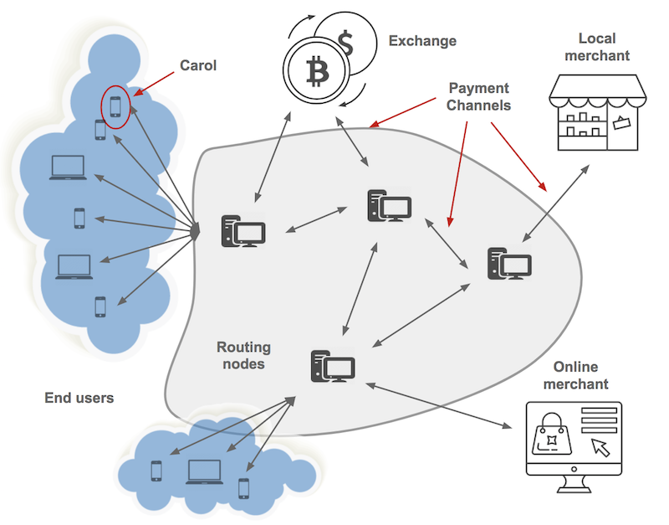
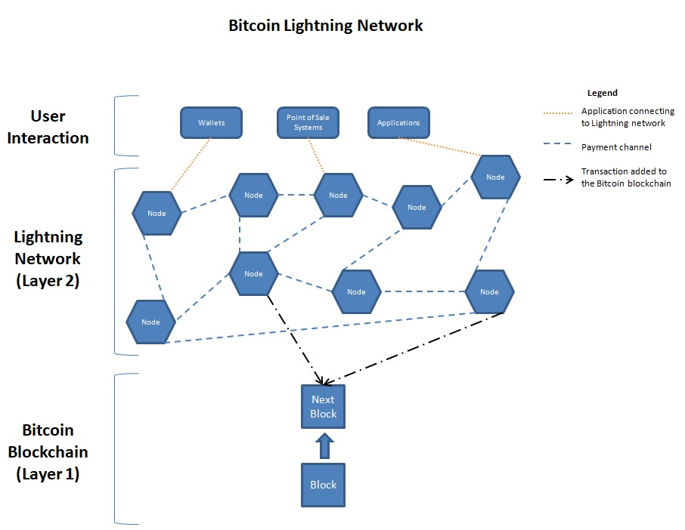

Slide 16
Approach 1: Integrated Lightning Network Implementation
05

Slide 17
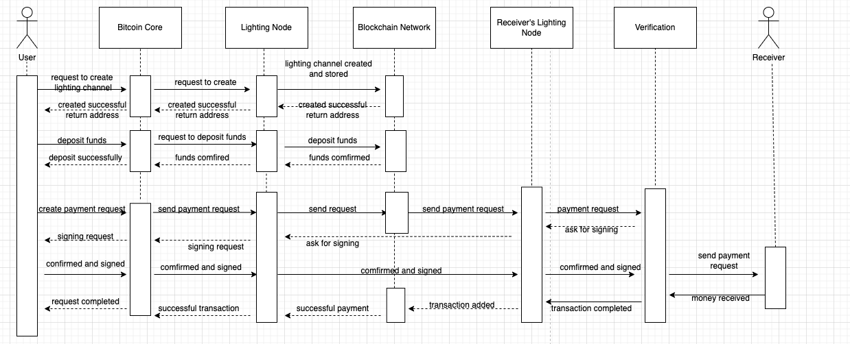
Approach 1: Transaction
For making transactions, the Lightning Network can be integrated into Bitcoin wallets to allow for faster and more cost-effective payments, as well as the introduction of smart contracts and multi-signature scripts. The process involves creating a Lightning channel, depositing funds, creating a payment request, verifying it, and adding the transaction to the blockchain network

Slide 19

Advantages:
Complete control:
The development team would have complete control over the Lightning Network implementation, allowing them to optimize it for the wallet framework.
Better user experience:
By integrating the Lightning Network implementation directly into the wallet framework, users would have a seamless experience and would not need to use a separate Lightning Network wallet.
External support:
Various components can be loaded by integrating an external Lightning network wallet

Slide 20
Disadvantages:
Complexity:
Integrating the Lightning Network implementation directly into the wallet framework adds complexity to the architecture.
Development time: Integrating the Lightning Network implementation directly into the wallet framework could take longer to develop and test.
Maintenance:
The development team would be responsible for maintaining and updating the Lightning Network implementation. May be hard to keep updating

Slide 21
Approach 2: External Lightning Network Wallet Integration
06

Slide 22
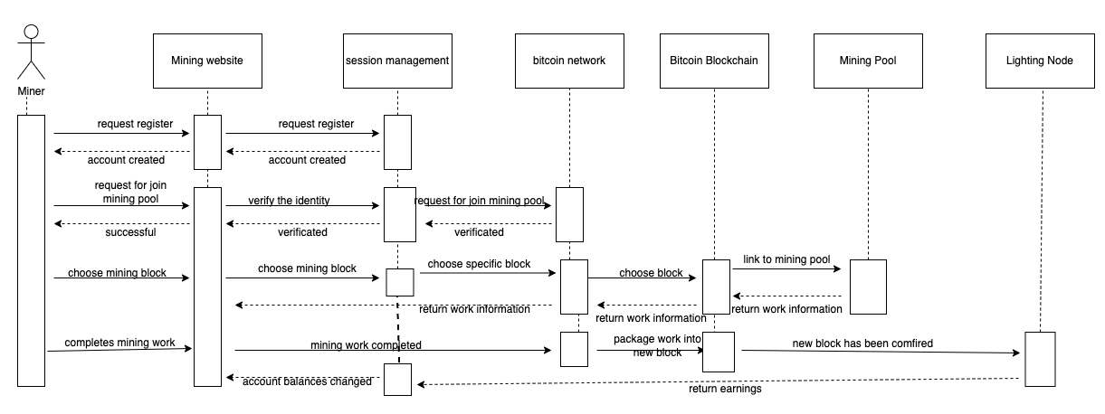
Approach 2: External Integration： mining
The second approach to realize the new feature is to integrate an external Lightning Network wallet into the wallet framework. For mining, miners can register on mining websites and join mining pools to mine Bitcoin. The stakeholders for this approach would be the users of the Bitcoin wallet, the development team, and the developers of the external Lightning Network wallet.

Slide 24

Advantages:
Simplicity:
Integrating an external Lightning Network wallet into the wallet framework is less complex than integrating it directly into the framework.
Faster development time: Integrating an external Lightning Network wallet into the wallet framework could be faster to develop and test.
External support:
Various components can be loaded in an external Lightning network wallet to get more functions

Slide 25
Disadvantage
Maintenance:
The development team would be responsible for maintaining and updating the Lightning Network implementation all the time.
Development time: Integrating the Lightning Network implementation directly into the wallet framework could take longer to develop and test.
Safety:
The new technology has not been fully tested, which could expose users to security risks, such as hacking.

Slide 26

Lessons learned
We suggest determining the components, relationships between the components, and actions of each component before drawing the diagram. like the mix of peer-to-peer and client-to-server architectural styles. The author recommends using a drawing application like draw.io and checking the diagram with groupmates before documenting it in a related folder. This paragraph provides practical advice for software development projects and emphasizes the importance of careful planning before implementation

Slide 27
THE END
THANKS

